Slide 1
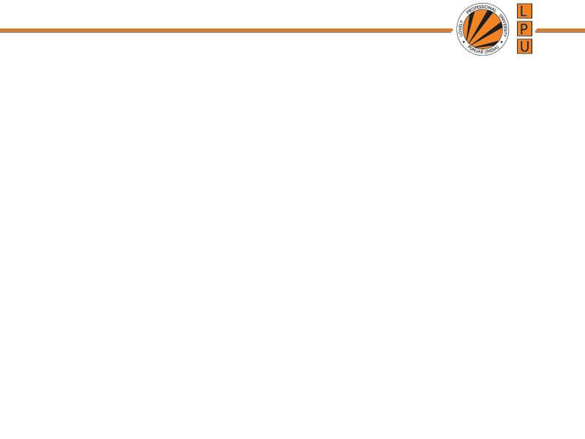
Introduction to Data Structures
Unit 1: Asymptotic analysis (Big-O notation)

Slide 2
Algorithm: Outline, the essence of a computational procedure, step-by-step instructions
Program: an implementation of an algorithm in some programming language
Algorithmic Problem
Specification of input
Specification of output as a function of input
?

Slide 3
Algorithmic Problem
Specification of input
Specification of output as a function of input
Algorithm
describes actions on the input instance
Infinitely many correct algorithms for the same algorithmic problem

Slide 4
( Infinitely many correct algorithms for the same algorithmic problem )
Program to Check Whether a Number is Prime or Not
Solution 1 | Solution 2
for(i=2; i<=n-1; ++i) { if(n%i==0) { Number n is not prime } } | for(i=2; i<=sqrt(n); ++i) { if(n%i==0) { Number n is not prime } }
Assume it takes 1ms for one % operation

Slide 5
( Infinitely many correct algorithms for the same algorithmic problem )
 | for(i=2; i<=n-1; ++i)……. (Solution 1) | for(i=2; i<=sqrt(n); ++i)…… (Solution 2)
Worst Case | n-2 divisions | Sqrt(n)-1 divisions | Assume it takes 1ms for one division operation
n=11 | 9 ms | 2ms | Not much difference
n=101 | 99ms | 9ms | Not much difference
n= 1000003 | 10⁶ ms or approx. 16 min | 10³ ms or approx. 1 sec | Significant difference
n= 10000000019 | 10¹⁰ms or approx. 115 days | 105 ms or approx. 1.66 minutes | Solution 1 not feasible
 | Correct solution but quiet Impractical time to solve any problem | Correct and Acceptable

Slide 6
( Infinitely many correct algorithms for the same algorithmic problem )
Correctness of the algorithm is not the only thing
Need to compare algorithm
Find out efficient algorithm
Analyse the algorithm (Complexity Analysis)
What is an Efficient Algorithm?
Taking less Running time (Analysis of Time complexity)
Using less Space (Analysis of Space complexity)

Slide 7
Time Space Trade off
A situation where the memory use can be reduced at the cost of slower program execution (e.g. using linear search for searching records on multiple criterion)
Or
the computation time can be reduced at the cost of increased memory use (e.g. using multiple indexes for searching)
As the relative costs of CPU cycles, RAM space, and hard drive space change—the appropriate choices for time space tradeoff have changed radically.

Slide 8
Time Complexity
The running time of an algorithm is the total number of primitive operations executed
The exact number of steps will depend on exactly what machine or language is being used
To avoid that problem, the Asymptotic Notation is used.
Algorithm complexity is rough estimation of the number of steps performed by given computation depending on the size of the input data, measured through Asymptotic Notation
Usually, the time required by an algorithm falls under three types −
Best Case − Minimum time required for program execution.
Average Case − Average time required for program execution.
Worst Case − Maximum time required for program execution.

Slide 9
Asymptotic Notation
Asymptotic notation of an algorithm is a mathematical representation of its complexity
An asymptote of a curve is a line such that the distance between the curve and the line approaches zero as one or both of the x or y coordinates tends to infinity.
It is a method of describing limiting behaviour.
e.g. If f(n) = n² + 3n, then as n becomes very large, the term 3n becomes insignificant compared to n².
The function f(n) is said to be "asymptotically equivalent to n², as n → ∞".

Slide 10
Commonly used asymptotic notations to calculate the running time complexity of an algorithm are
Ο Notation (Big Oh Notation)
Ω Notation (Omega Notation)
θ Notation (Theta Notation)

Slide 11
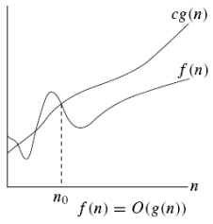

Big Oh Notation - Asymptotic upper bound
It measures the worst case time complexity or the longest amount of time an algorithm can possibly take to complete.

Slide 12
Example
The running time is O(n²) means that there is a function f(n) that is O(n²) such that for any value of n (regardless of size) the running time of that input is bounded from above by the value f(n).
3 * n² + n/2 + 12 ∈ O(n²)
2. 4*n*log₂(3*n+1) + 2*n-1 ∈ O(n * log n)

Slide 13
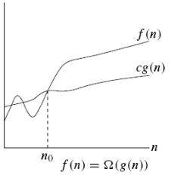

Ω Notation - Asymptotic lower bound
It measures the best case time complexity or the best amount of time an algorithm can possibly take to complete
the best case performance of an algorithm is generally not useful, the Omega notation is the least used notation among all three.

Slide 14
Example
When we say that the running time (no modifier) of an algorithm is Ω (g(n)),
it mean that for each value of n, the running time on that input is at least a constant times g(n), for sufficiently large n.
n³ + 20n ∈ Ω(n²)

Slide 15
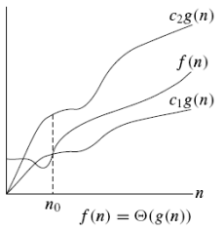

Θ Notation – bounds a functions from above and below
It measures the average case time complexity

Slide 16

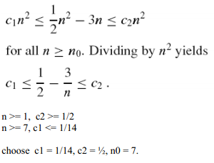
Example

Slide 17
f(n) = 3n + 2 g(n) = n
If we want to represent f(n) as Θ(g(n)) then
C₁ g(n) <= f(n) <= C₂ g(n) C₁ n <= 3n + 2 <= C₂ n
Above condition is always TRUE for all values of C₁ = 1, C₂ = 4 and n >= 1

Slide 18
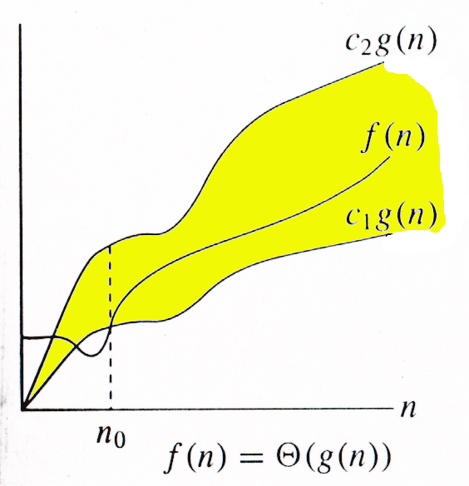
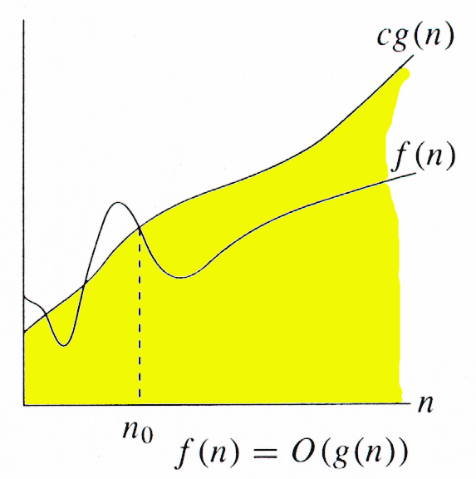
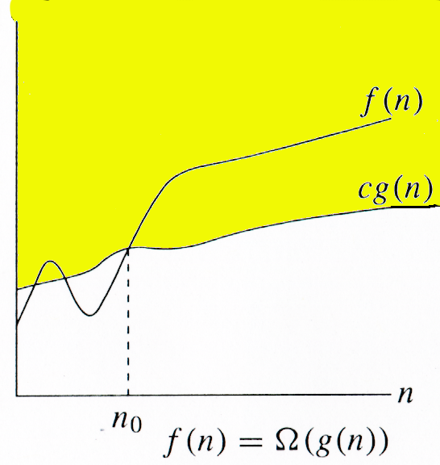
Relations Between Θ, O, Ω

Slide 19
Measuring Efficiency of an algorithm
We are more interested in finding out the Worst Case Complexity or Big O

Slide 20
Common Asymptotic Notations
Constant | Ο(1)
Logarithmic | Ο(log n)
Linear | Ο(n)
Log Linear | Ο(n log n)
Polylogarithmic | O((log(n))^{c})
Quadratic | Ο(n²)
Cubic | Ο(n³)
Polynomial | n^{Ο(1)}
Exponential | 2^{Ο(n)}

Slide 21
//
O(1)
Time complexity of a function (or set of statements) is considered as O(1) if it doesn’t contain loop, recursion and call to any other non-constant time function.
e.g. swap function
A loop or recursion that runs a constant number of times is also considered as O(1)
e.g. for (int i = 1; i <= 10; i++) {
// some O(1) expressions
}

Slide 22
O(n)
Time Complexity of a loop is considered as O(n) if the loop variables is incremented / decremented by a constant amount.
e.g.
for (int i = 1; i <= n; i += c) {
// some O(1) expressions
}
or
for (int i = n; i > 0; i -= c) {
// some O(1) expressions
}

Slide 23
O(n^{c})
Time complexity of nested loops is equal to the number of times the innermost statement is executed.
e.g. O(n²)
for (int i = 1; i <=n; i += c) {
for (int j = 1; j <=n; j += c) {
// some O(1) expressions
}
}

Slide 24
e.g. O(n³)
for (int i = 1; i <=n; i += c) {
for (int j = 1; j <=n; j += c) {
for(int k = 1; k <=n; j += c) {
// some O(1) expressions
}
}
}

Slide 25
O(log n)
Time Complexity of a loop is considered as O(Logn) if the loop variables is divided / multiplied by a constant amount.
e.g.
for (int i = 1; i <=n; i *= c) {
// some O(1) expressions
}
or
for (int i = n; i > 0; i /= c) {
// some O(1) expressions
}

Slide 26
O(log log n)
Time Complexity of a loop is considered as O(LogLogn) if the loop variables is reduced / increased exponentially by a constant amount
e.g.
// Here c is a constant greater than 1
for (int i = 2; i <=n; i = pow(i, c)) {
// some O(1) expressions
}
//Here fun is sqrt or cuberoot or any other constant root
for (int i = n; i > 0; i = fun(i)) {
// some O(1) expressions
}

Slide 27
O((log n)²)
e.g.
for(int i = 0; i < n; i*=2) {
for(int j = 1; j < n; j *= 2){
// some O(1) expressions
}
}

Slide 28
O(n log n)
e.g.
for(int i = 0; i < n; i++) {
for(int j = 1; j < n; j *= 2){
// some O(1) expressions
}
}

Slide 29
O(2^{n})
e.g.
Solution of Tower of Hanoi Problem

Slide 30
Basic Rules for calculating complexity
1. Nested loops are multiplied together. 2. Sequential loops are added. 3. Only the largest term is kept, all others are dropped. 4. Constants are dropped. 5. Conditional checks are constant (i.e. 1).

Slide 31
What is the time complexity
for(int i = 0; i < n; i++) {
for(int j = 0; j < 2; j++){
// some O(1) expressions
}
}

Slide 32
Ans: O(n)

Slide 33
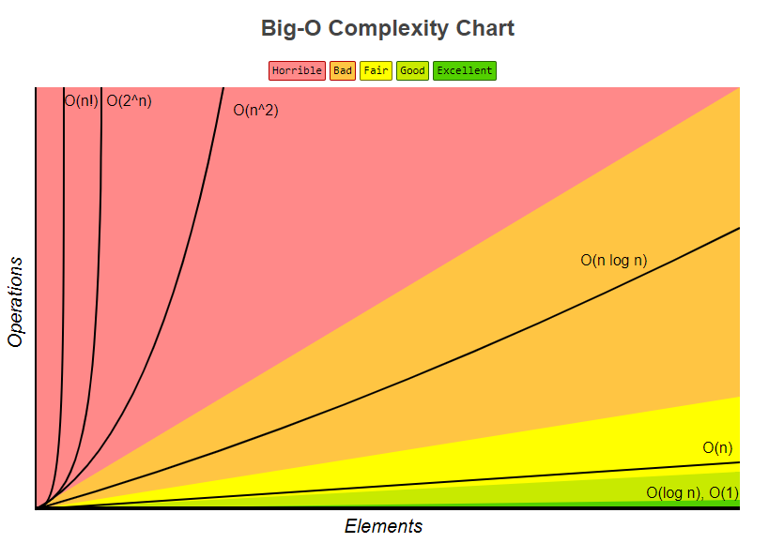

Slide 34
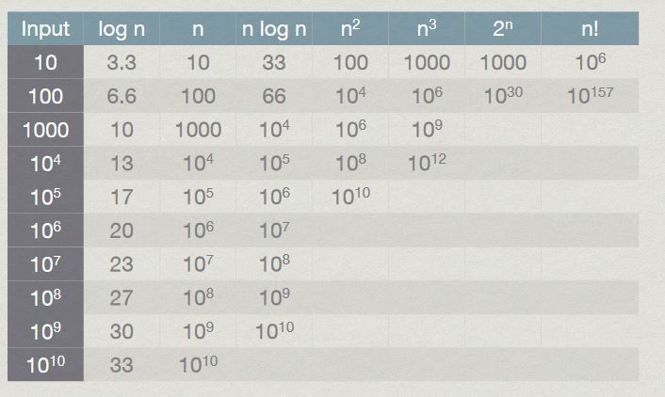

Slide 35
Complexity Analysis of Recursive Program
Time complexity of a recursive function can be written as a mathematical recurrence relation
A recurrence relation is an equation that recursively defines a sequence where the next term is a function of the previous terms
Expressing F_{n} as some combination of F_{i} with i<n
e.g. Factorial calculation, Fibonacci series generation

Slide 36
Ways for solving recurrences
Substitution Method: We make a guess for the solution and then we use mathematical induction to prove the guess is correct or incorrect.
Recurrence Tree Method: In this method, we draw a recurrence tree and calculate the time taken by every level of tree. Finally, we sum the work done at all levels.

Slide 37
Complexity Analysis of Factorial Function
Definition: Fact(n): if (n==0) then
return 1
else
return n * Fact(n-1)
Assume 1 operation takes 1 unit of time
Comparision (n==0) -> 1 Unit
n-1 -> 1 Unit 3 Units of time
* -> 1 Unit
As per definition,
T(n) = T(n-1) + 3
T(0) = 1

Slide 38
Complexity Analysis of Factorial Function
T(n) = T(n-1) + 3
= T(n-2) + 6
= T(n-3) + 9
…….
= T(n-k) + 3 *k ------ eq. 1
We want to go till (n-k) = 0 or k = n
Substituting k eq. 1, T(n) = T(0) + 3 * n
Since T(0) = 1, T(n) = 1 + 3 * n which is O(n)

Slide 39
Complexity Analysis of Fibonacci Term
Definition: Fib(n): if (n<=1) then
return n
else
return Fib(n-1) + Fib(n-2)
Assume 1 operation takes 1 unit of time
Comparision (n<=0) -> 1 Unit
n-1 -> 1 Unit 4 Units of time
n-2 -> 1 Unit
+ -> 1Unit
As per definition,
T(n) = T(n-1) + T(n-2) + 4
T(0) = T(1) = 1

Slide 40
Complexity Analysis of Fibonacci Term
T(n) = T(n-1) + T(n-2) + 4
Since, T(n-1) ≈ T(n-2)
T(n) =2*(T(n-2)) + C , Similarly
= 2*(2*T(n-4) +C) +C
= 4*(T(n-4) + 3*C)
= 8*(T(n-6) + 7*C)
= 16*(T(n-8) + 15*C)
= …….
=2^{k}*(T(n-2*k) + (2^{k} – 1)*C ) ------ eq. 1
We want to go till (n-2*k) = 0 or k = n/2
Substituting k eq. 1, T(n) = 2^{n/2} *(T(0) + (2^{n/2} -1)*C)
Since T(0) = 1, T(n) = 2^{n/2} *(1+ (2^{n/2} -1)*C) which is O(2^{n})

